Slide 1

Gotham
T-DIT-700 MSc2020
Gotham T-DIT-700

Slide 2
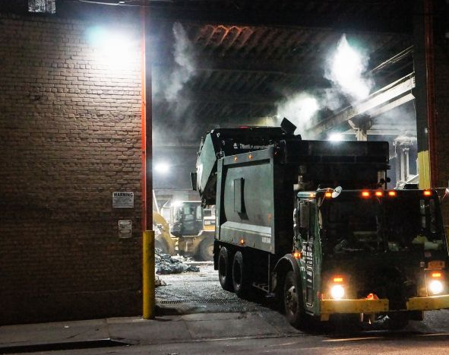
Summary 1. Introduction 2. What will be change 3. Change Management 4. Mc Kinsey Model / Leavitt diamond 5. Other tools 6. Communication 7. Conclusion

Slide 3
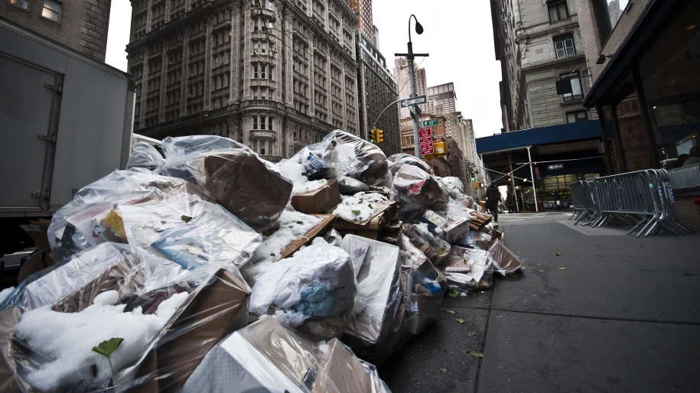
Introduction
The city hall has decided to implement a vast change plan in order to renew and reorganize its garbage collection system.

Slide 4








Changes decided by the town hall
1- Use the working time app
2- Equip trucks with GPS
3 – Equip employees with electronic device
4 - Use drones to check the collections and the state of cleanliness of the streets
5 – Smart trashes, with sensor
6 – Public app for incident reporting
7 – Monthly performance reporting

Slide 5
Change management
The benefits :
Assess and understand the need and the impact of change.
Align resources within the business to support the change
Reduce the time needed to implement change
Support staff and help them understand the change process
Plan and execute an effective communication strategy
Minimise resistance to change
Reduce stress and anxiety associated with change
Minimise the possibility of change failure
...

Slide 6
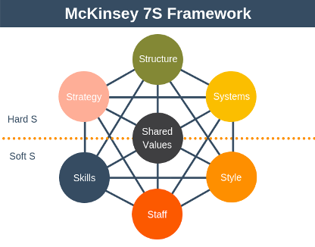
Mc Kinsey Model
5 steps :
Understand the current situation.
Determine the situation
Determine your action plan to reach the desired situation
Execute the action plan
Perform a periodic review of the situation

Slide 7
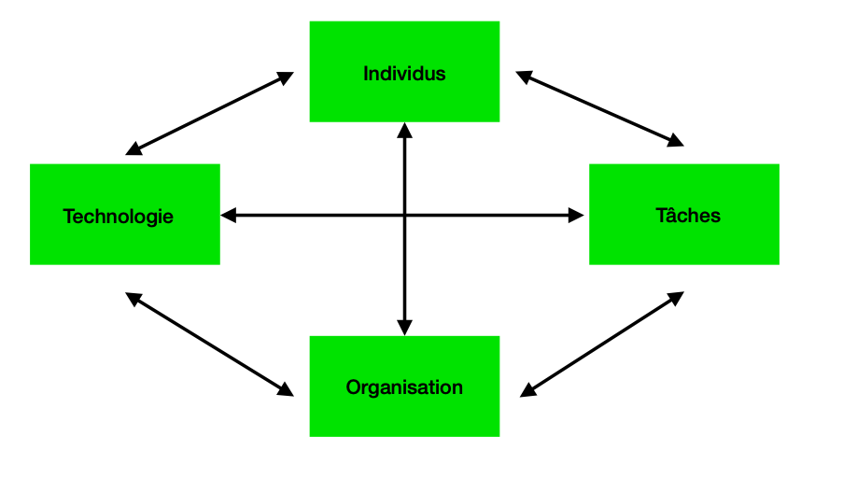
Leavitt diamond
Used to analyze the impact of a change in one of the components.

Slide 8
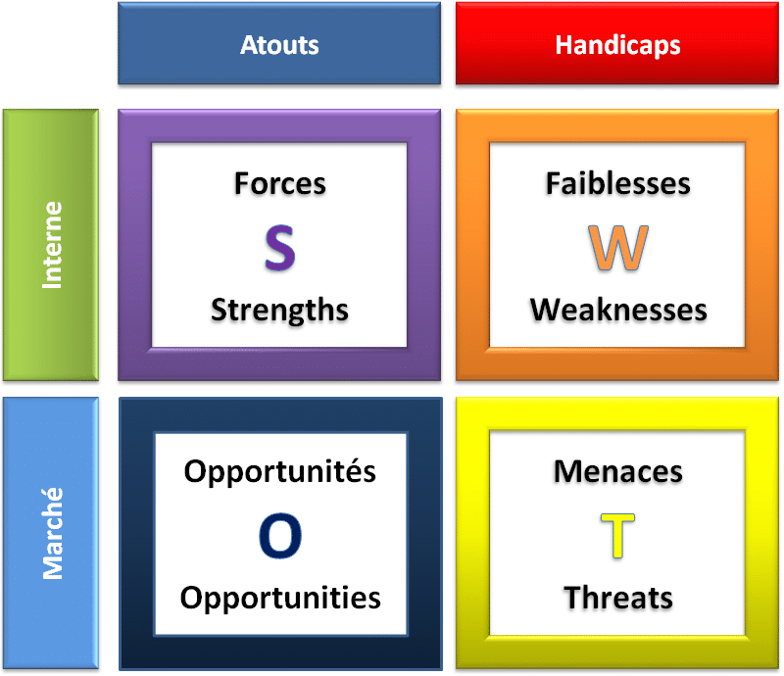
SWOTT
It is a source of information for strategic planning.
Builds organization’s strengths.
Reverse its weaknesses.
Maximize its response to opportunities.
It helps in identifying core competencies of the firm.
It helps in setting of objectives for strategic planning.
It helps in knowing past, present and future so that by using past and current data, future plans can be chalked out.

Slide 9
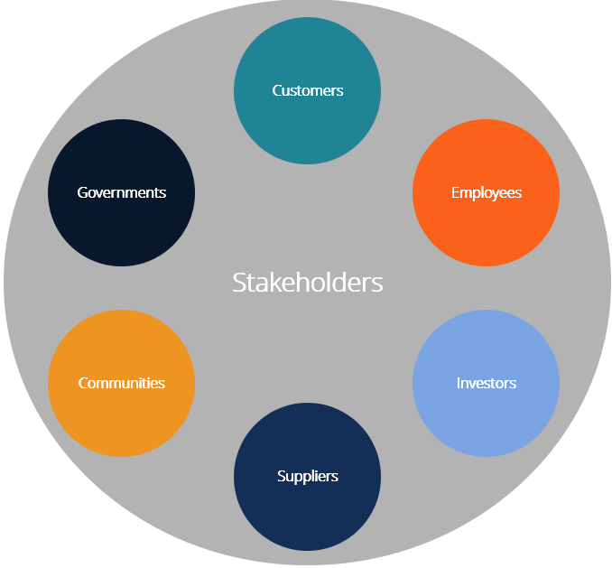
Stakeholder
Identify all the stakeholders in the project

Slide 10
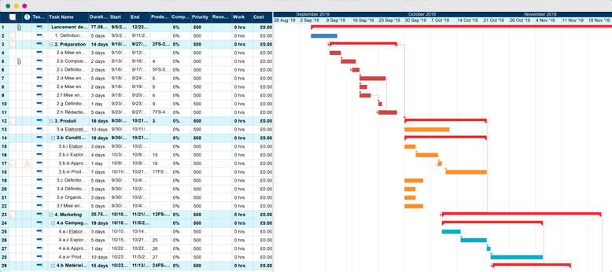
Gantt
Clear representation of project tasks
Effective time management
Better resource allocation

Slide 11
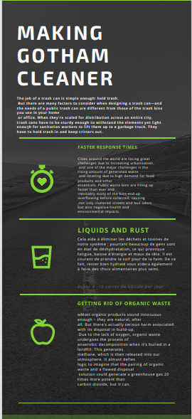

Communicating with the Citizens
Effectively communicating with the citizens of Gotham to help the project run smoothly
Using informative infographics that offer concise information on the necessity of this project
Explaining the current problem and offering solutions

Slide 12
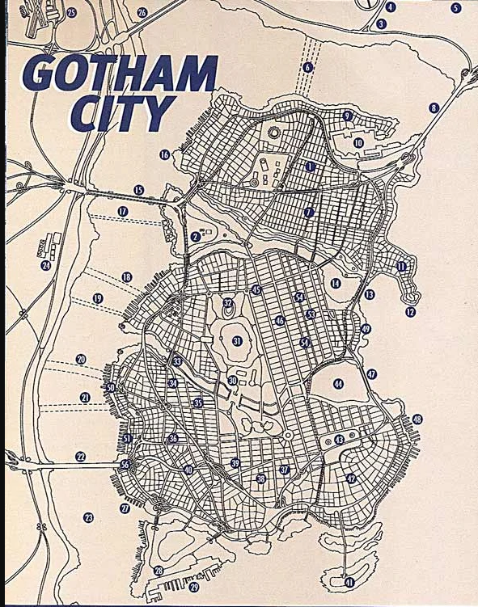
Communication with the employees
Making sure all employees suggestions and complaints are heard because they will be the ones on the field
Designating a representative in each district to talk directly to upper management about the current situation on the field
Using the representatives to be able to implement the changes in each district in a more agile fashion

Slide 13

Thank you for listening
Do you have questions ?

